Slide 1
Economics Project 1 MAGGI STALLS
Group No : 9

Slide 2
INTRODUCTION
Maggi stalls are a huge rage now-a-days. Because of the popularity of the ready to make ramen- maggi, there has been an increase in the no. of stalls all over Ahmedabad and other cities.
For our project we are considering the maggi stalls nearby the university area.
Maggi is an international brand of seasonings, instant soups, and noodles that originated in Switzerland.
Most of the stalls here have been since 10 years and some have been opened recently. We have surveyed 4 stalls among them.

Slide 3
BUSINESS IDEA
Stall1 – The owner got the idea of maggi because he had an insight about the flavor and the fact that growing popularity of maggi would be advantageous over the existing sandwich stall. They started about 12 years ago.
Stall-2- This owner had a job before but he saw that maggi stalls were a huge thing now a days, people were all about maggi so he thought that having a maggi stall would be financially beneficiary to him. He started about a year ago.
Stall-3 – The stall owner had a coffee stall before the maggi stall and had personal preference of maggi and so decided that a maggi stall would do him good. He started about 10 years ago.
Stall-4 –Two people had an idea of starting the maggi and they previously owned frankie stall. They started from 2003.

Slide 4
LOCATION SELECTION
All of these people had the same inspiration of selecting the place of the stall and it was that the area itself i.e. the university area has around 7-8 colleges, 2 schools and this area being one of the highly populated areas they chose this place. Not only youth but even families visit this place. So they found it the most suitable one.
INGREDIENTS :
Major ingredient is the maggi noodles itself, and the rest is just water and the spices they use .
There are around 40 different flavors. Most of the items on the stall are common among them.However some of them do experiment with different types of ingredients like chocolates, Veg Cheese Makai Tadka, lasagnamaggi , Mexican maggi.

Slide 5
ADVERTISEMENTS
Stall-4 advertises through radio some times. However, the
stall-2 started newly he said he really didn’t need advertising because already the maggi business was booming.
FUTURE PLANS OR ANY BRANCHES
Stall 1 Has another stall of sandwiches
Stall 2 Does not have any branches
Stall 3 Has a coffee stall
Stall 4 Has a frankie stall

Slide 6
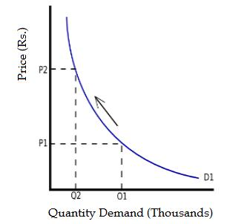
DEMAND ANALYSIS
LAW OF DEMAND:
It is normally depicted as an inverse relation of quantity demanded and price; the higher the price of the product, the less the consumer will demand.

Slide 7
FACTORS AFFECTING DEMAND
Price of relative goods: Demand for maggi is also influenced by the change in price of relative goods.
1) Substitute
2) Complimentary
RELATED GOODS AND QUANTITY
Stall 1 Did not increase any prices because changing the menu would cost him loss.
Stall 2 had increased prices with the increase in the price of the related goods like tomatoes capsicum and onions from 30 rupees to 40 rupees keeping the quantity same.
Stall 3 The same price since last 4 years.
Stall 4 increases the prices of Maggi only if the price of maggi(packet) increases.

Slide 8
INCOME OF THE CONSUMER
There is a direct relationship between income of consumer and demand. In our case majority consumers are the students . Thus they do not have an income instead they have their pocket money
.
TASTE AND PREFERENCES
Taste and preferences of the consumers also influence the demand to greater extent. The regular customers prefer fixed stalls but new customers try new stalls after the recommendation from their friends.
GOVERNMENT POLICIES
As the study shows, there was a steep reduction in the demand of Maggi as before the infamous maggiban ,maggi sort of had a monopoly in the ready to make food market . But on june 4, 2015 , the Gujarat FDA, banned the noodles for 30 days after 27 out 39 samples were detected with objectionable level of metallic lead and msg.

Slide 9
TIME
Time is an important factor that affects the demand of Maggi e.g. the demand increases during the fest going in the nearby colleges, during winters and the beginning of the semesters. There is decrease in demand the vacations.
AGE GROUP OF THE POPULATION
This product is mostly liked by age group of 18 -20 yrs and also adults so the age groups are affecting the demand of the product and by the increase in the population, the demand of the product also increases.

Slide 10
SHIFT IN DEMAND CURVES
Shift in demand curves refers to the change in demand due to change in factors other than price.
Shift can be of 2 types-
1) Upward shift
2) Downward shift

Slide 11
UPWARD SHIFT
When the demand for product increases, price being constant, due to change in other factors e.g. Increase in income.
If there’s an increase in the income of consumers in the future, then there’s a possibility that the consumer will shift from normal maggi to a costlier maggi.
At the time of festive seasons near the colleges the demand increases.

Slide 12
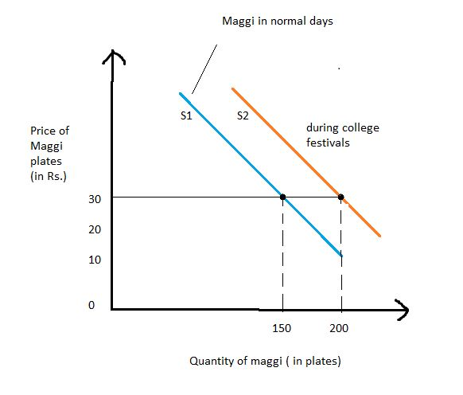
Upshift of Demand Graph

Slide 13
DOWNWARD SHIFT
When the demand for the product decreases at same price.eg the demand for maggi reduces when people found that there was metallic led found in few samples of maggi.
CHANGE IN DEMAND
During the vacation period there is a 30% - 50% decrease in the demand as the stalls are surrounded by colleges all around so during the vacation period the demand of maggi decreases also because of the new colleges that came up from time to time there was an increase in the demand too

Slide 14
Downshift of Demand Graph

Slide 15
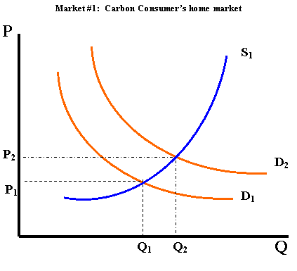
SUPPLY ANALYSIS
LAW OF SUPPLY
It states that if the price of a product increases, quantity supply will increase as the supplier will be willing to supply more to earn more profit.

Slide 16
FACTORS AFFECTING SUPPLY
PRICE:
The price is positively related with quantity supplied for maggi, in short run if there is an increase in the price of maggi, the producers will be willing to produce more of the product.
NUMBER OF CONSUMER:
In the case of maggi there are large number of consumer, as a result the supplier are willing to supply more to cater the needs for the large number of customer.
PRICE OF INPUTS:
Includes gas cylinder, maintenance of the stall , other food products etc. if there is no scarcity in the supply of these factors so the cost for these factors will reduce as a result the producer is willing to supply more products at same price.

Slide 17
SHIFT IN SUPPLY CURVES
Shift in supply curve means change in quantity supplied due to others factors while price remains the same.
Upward shift.
Downward shift.

Slide 18
Upward Shift In Supply Curve
Here, price being constant other factors are to
be taken in consideration.
Lets take an example of cheese maggi.
If the prices of cheese increases, but if the price
of cheese maggi is kept constant then there
would be a decrease in supply.

Slide 19
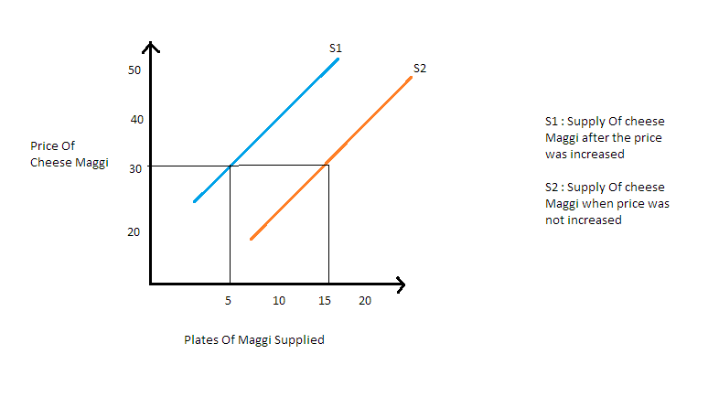
UPWARD SHIFT

Slide 20
Downward Shift in Supply Curve
Here, the price keeping constant other factors are to be taken in consideration.
Lets take the fact of maggi-ban. When there was objectionable amount of lead found in maggi, there was a decrease in supply of maggi , no matter price remaining same.

Slide 21
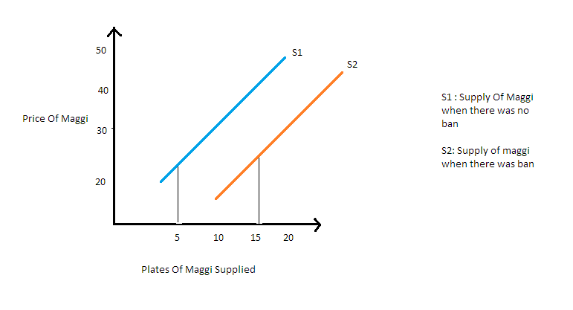
DOWNWARD SHIFT

Slide 22
CHANGE IN SUPPLY
With the increase in price change in supply to increase the profit.
Difference the prices of maggi over time
Stall 2 During the beginning that is before a year or so it was rupees 30 and after that it had changed to rupees 40
Avg Maggi sold in a day
Stall 2 About 50 plates a day
Stall 3 About 150 plates a day

Slide 23

ELASTICITY ANALYSIS
ELASTICITY OF DEMAND:
The elasticity of demand for a commodity is the rate at which quantity changes as the price changes.

Slide 24
DETERMINANTS OF ELASTICITY
AVAILABILITY OF SUBSTITUTES:
In the case of maggi substitutes are not easily available in the market.So even if there is a increase in the price of maggi, the consumers will not shift their intake from maggi.
TIME: In our maggi case the demand elasticity is generally constant. Even if the price increases,the youth still has the same demand for it.
INCOME LEVEL: In our maggi case, the majority consumers are the youths. They do not have an income, they get a fixed pocket money. So if the maggi prices increases, the demand decreases.
PROPORTION OF INCOME SPENDS ON THE GOODS: Maggi is that product which is meant for the youngsters. In the long run the demand is relatively inelastic because even in the long run if there is a increase in price of maggi even the hard core maggi consumer will shift their preference because of the constrain in their pocket money whereas in short run the demand is inelastic

Slide 25

CROSS ELASTICITY OF DEMAND
It is ratio of proportionate change in quantity demanded of Y to a given proportionate change in the price of the relative commodity X.

Slide 26
Before the infamous maggiban ,maggi sort of had a monopoly in the ready to make food market . But on june 4, 2015 , the Gujarat FDA, banned the noodles for 30 days after 27 out 39 samples were detected with objectional level of metallic lead and msg.
After that maggi decided to take the product off shelf which left the stall owners with no choice but to drop the sales of maggi and switch over to the substitutes like yippee and then to wai-wai .
Wai-wai then became really popular with the consumers but it wasn’t as popular as maggi. And during the ban the selling from stalls of coffee, sandwiches and frankie rose. But as soon as maggi was back in the market its sales boomed 30% of what it was.

Slide 27
CONCLUSION
These were the analysis of our product maggi.
Finally we found that the stalls have a same
pattern of increase and decrease in demand of
Maggi.
Also the increase in prices of different maggi varieties is the same in all the stalls.
Inshort the increase in demand,supply,prices etc is similar in all the stalls.

